Slide 1
Software Metrics for Architects
Alexander v. Zitzewitz
a.zitzewitz@hello2morrow.com
blog.hello2morrow.com
@AZ_hello2morrow

Slide 2
Agenda
The case for using metrics
Fitness function
Some useful code metrics

Slide 3
Continuous Improvement
Define Goals
Implement
Verify/Measure
Improve

Slide 4
Why you should use metrics
They are the foundation of the crucial “verify/measure” node of the continuous improvement loop
Free tools like Sonargraph-Explorer already provide a lot of metrics
Automated measurement in CI builds allows you to discover harmful trends early enough
You can enforce quality standards by using metrics in quality gates

Slide 5
Why metrics are underutilized
Perceived lack of tools or knowledge about them
Lack of knowledge about metrics and how to read them
Often a single metric does not tell the whole story
Who has time for this?
Metrics are most useful when they are used to trigger actions
Intimidating choices, which metrics should I use?

Slide 6
Agenda
The case for using metrics
Fitness function
Some useful code metrics

Slide 7
Metrics quantify how well you met your goals
Without measuring you are blind
Trust is good – control is better (Lenin)
But what are the goals?
Maintainability?
Scalability?
Performance?
Evolvability?
Testability?
Many more “ilities”…

Slide 8
Prioritize goals
Pick 3 to 4 “-ilities” as your top goals
Maintainability should always be one of them (unless you write code that will never change)
Define and quantify what it means to achieve a goal

Slide 9
Fitness functions
Define how well you achieved your goal
Can be based on
Code metrics derived from static analysis
Operational metrics
Production metrics
Manually collected metrics
Automation is recommended, but not always possible
Here we focus on code metrics

Slide 10
More about fitness functions

Slide 11
Agenda
The case for using metrics
Fitness function
Some useful code metrics

Slide 12
This could have been avoided using metrics
Architecture of Apache-Cassandra (ML: 9%, PC: 62%)

Slide 13
How can we measure Spaghettization?

Slide 14
Attributes of Spaghetti Code?
High coupling
Lots of cyclic dependencies
No clear separation of responsibilities, e.g. features are spread all over the place
Sounds familiar ?! 90% of systems suffer from some variety of this problem

Slide 15
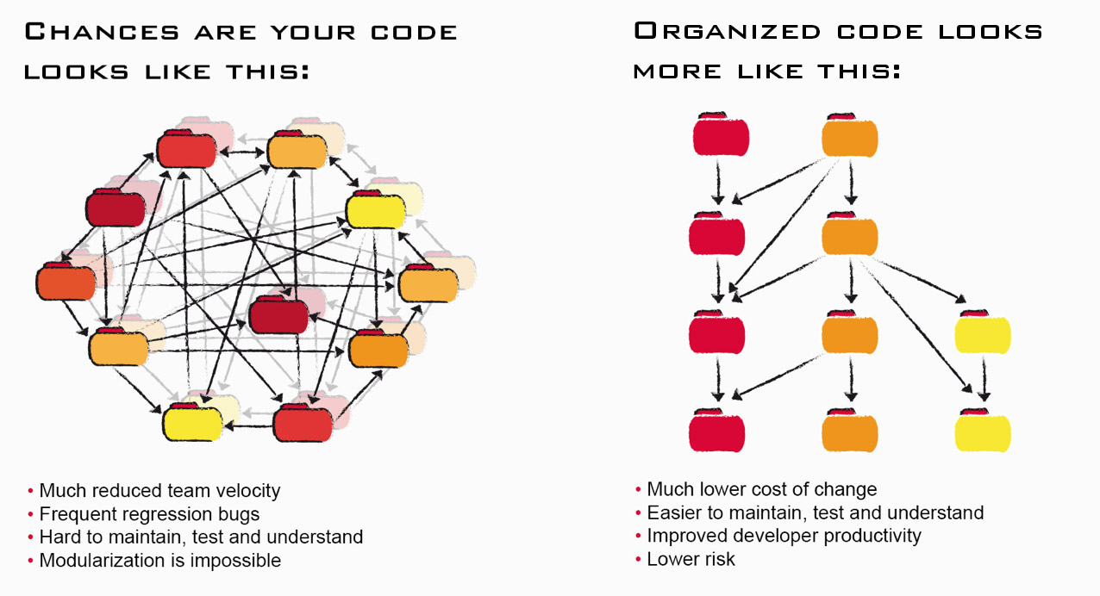
Spaghetti Code vs Clean Code

Slide 16
Good metrics to identify Spaghetti Code
ACD (Average Component Dependency): measures coupling
Maintainability Level: measures coupling and cyclic dependencies
Relative Cyclicity: focus on cyclic dependencies
Structural Debt Index (SDI): focus on cyclicity

Slide 17
ACD – a metric to measure coupling
ACD = Average Component Dependency
Average number of direct and indirect dependencies
rACD = ACD / number of elements
NCCD: normalized cumulated component dependency
6
3
6
Cycles
3
3
1
1
6
6
1
1
1
2
3
2
1
6
1
CCD = 15
ACD = 15/6 = 2,5
Dependency Inversion ACD = 12/6 = 2
ACD = 26/6 = 4,33

Slide 18
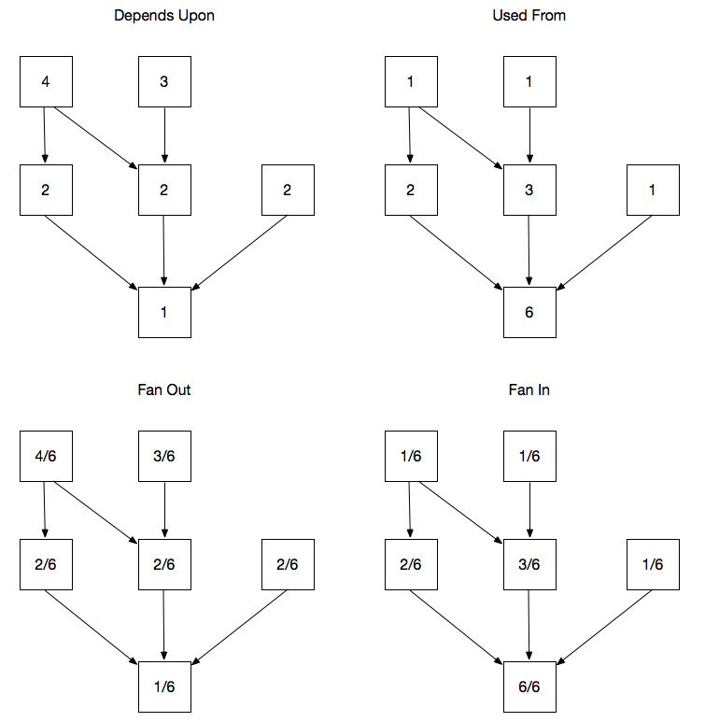
Low level metrics to measure coupling

Slide 19
Propagation Cost (MacCormack, Rusnak, Baldwin)
Percentage value to indicate coupling
Smallest value is 1/n*100, indicates no coupling
Biggest value 100 means 100% coupling
Calculated as average fan in (equals average fan out)
Bad values are bad except for small systems
Good values need to be verified by other metrics
Usually shrinks with system size

Slide 20
What is a cycle group?

Slide 21
Cyclicity
The cyclicity of a cycle group is the square of its size, e.g. a group with 3 elements has a cyclicity of 9.
System / module cyclicity is the sum of all cycle group cyclicity values.
Relative cyclicity is defined as:
n is the total number of elements

Slide 22
Maintainability Level (ML)
Experimental metric in Sonargraph
Implemented as percentage: 100% is the perfect score
Should be stable, when there are no major changes to architecture and design
Measure decoupling and successful verticalization
Reducing coupling and cyclicity will improve metric
One of several indicators of design quality
Recommended value: 75% or more

Slide 23
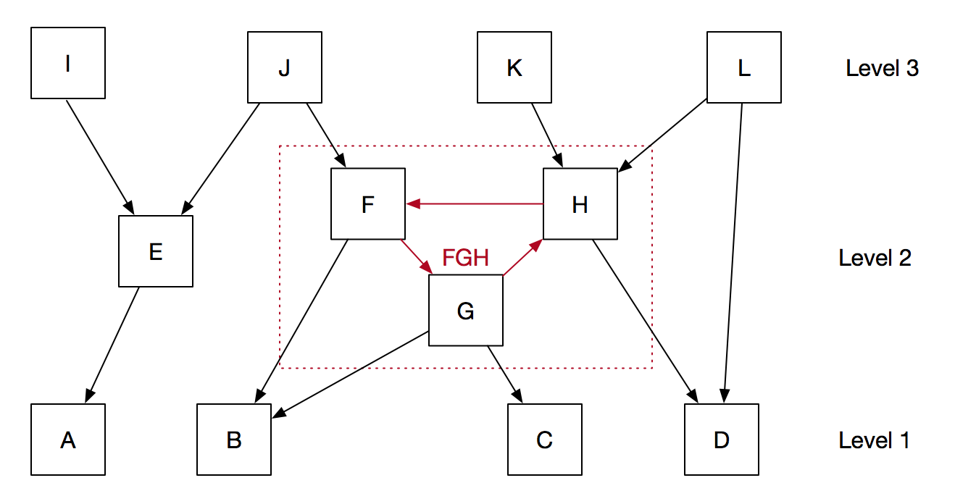
ML Implementation
Fan In (ML): percentage of higher-level components influenced by a given component
E.g. A influences E, I and J, 3 of 8 higher level components. Its “Fan In (ML)” value therefore is 3/8 or 37.5%.
Cycle groups are condensed into a single logical node. I the example F, G and H are condensed into a new node called FGH (weight of 3).
Fan In (FGH) is ¾ = 75% (it influences J, K and L – 3 of 4 nodes in level 3.
Fan-In (ML) of B, C and D is 6/8 = 75%. Cycle groups have a negative influence.
Fan in of elements in highest level is always 0.

Slide 24
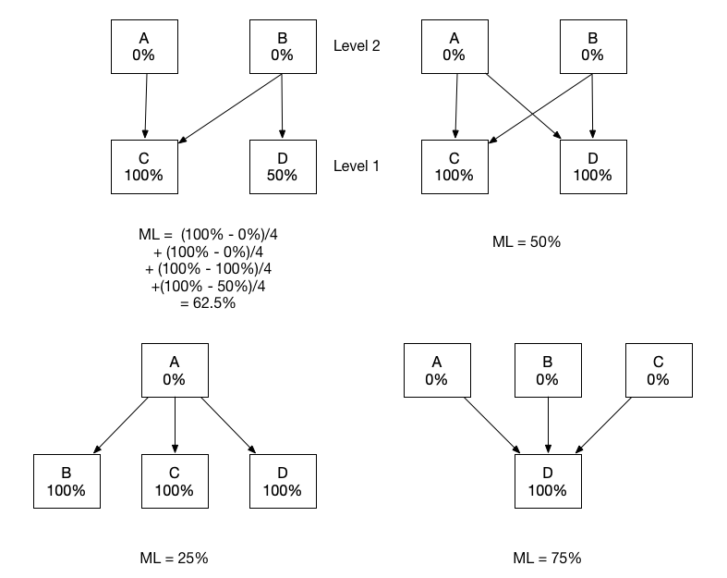
ML Example Calculations

Slide 25
ML Observations
The more components are in the topmost level, the better. Those components can be changed without influencing the rest of the system.
Cycle groups have a negative influence, especially when the have more than 5 elements.
Successful verticalization (minimizing dependencies between vertical silos) leads to better values.
We added an alternative calculation measuring package cyclicity. The ML value of a module is the minimum of both values.
Does not work very well for small number of nodes. Therefore we introduced a sliding minimum.

Slide 26
Finetuning ML
Penalty for cycle groups with more than 5 elements
Does not work too well for small modules with less than 100 components
Fixed by introducing a sliding minimum value for modules with less than 100 components
Metric is blind regarding package/namespace structure
Fixed by adding an alternative calculation (1 – relativePackageCyclicity) and then using the minimum value between this value and ML
Also added a sliding minimum value for modules with less than 20 packages/namespaces
System wide metric is calculated as the weighted average of the largest modules

Slide 27
ML for Nerds
Details can be found on blog.hello2morrow.com
http://blog.hello2morrow.com/2018/12/a-promising-new-metric-to-track-maintainability

Slide 28
Structural Debt Index (Sonargraph)
This metric focusses on cyclic coupling and how difficult it would be to break the cycles
Cyclic dependencies are a good indicator of structural erosion
For each cycle group two values are computed:
How many links do I have to cut to break the cycle group
Total number of code lines affected by the links to break
SDI = 10 * LinksToBreak + TotalAffectedLines
SDI is then added up for modules and the whole system
Can be computed on component level and on package/namespace level

Slide 29
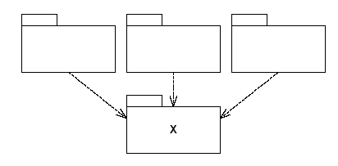
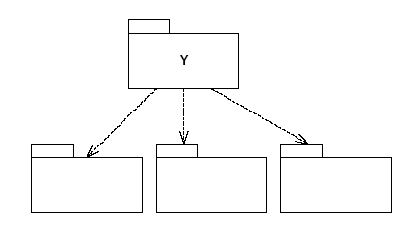
Architecture metrics of Robert C. Martin
X is „stable“
Y is „instable“
D_{i} = Number of incoming dependencies
D_{o} = Number of outgoing dependencies
Instability I = D_{o} / (D_{i}+D_{o})
Build on abstractions, not on implementations

Slide 30
Abstractness (Robert C. Martin)
N_{c} = Total number of types in a type container
N_{a} = Number of abstract classes and interfaces in a type container
Abstractness A = N_{a}/N_{c}

Slide 31
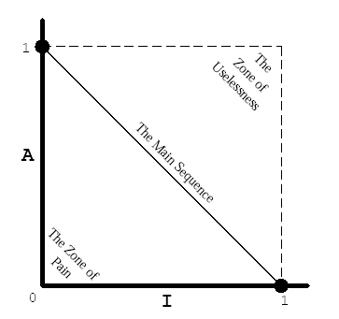
Metric „distance“ (Robert C. Martin)
D = A + I – 1
Value range [-1 .. +1]
Negative values are in the „Zone of pain“
Positive values belong to the „Zone of uselessness“
Good values are close to zero (e.g. -0,25 to +0,25)
„Distance“ is quite context sensitive

Slide 32
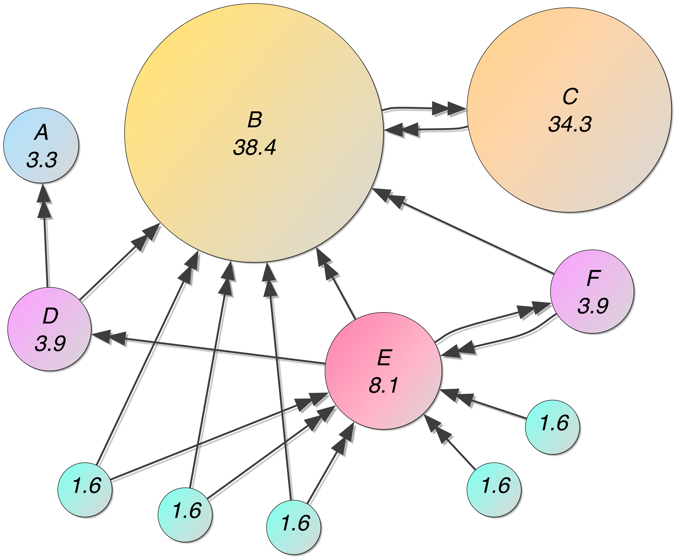
Component Rank
Is based in Google’s page rank metric
Calculated iteratively until values stabilize
Described in a Wikipedia article

Slide 33
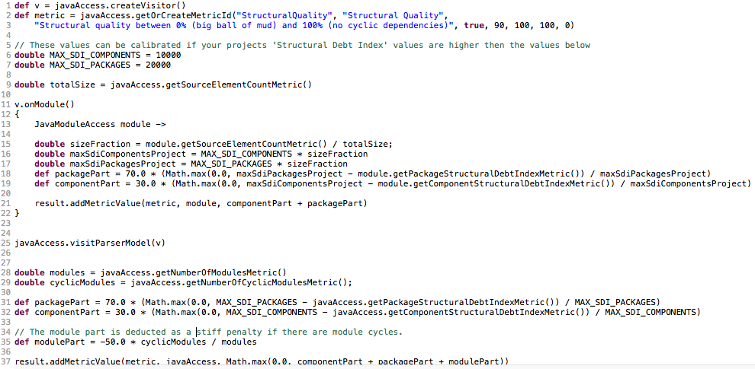
Experimenting with your own metrics: StructQuality

Slide 34
Q & A a.zitzewitz@hello2morrow.com blog.hello2morrow.com @AZ_hello2morrow

